Slide 1
Part 3. Machine Learning – Compression Deep Neural Network

Slide 2
Lecture Content
1.
2.
Machine Learning Applications Overview
Machine Learning Deployment Challenges
3.
4.
Machine Learning Compression Techniques
Implementation – Applications Deployment

Slide 3
1.
ML Applications Overview

Slide 4
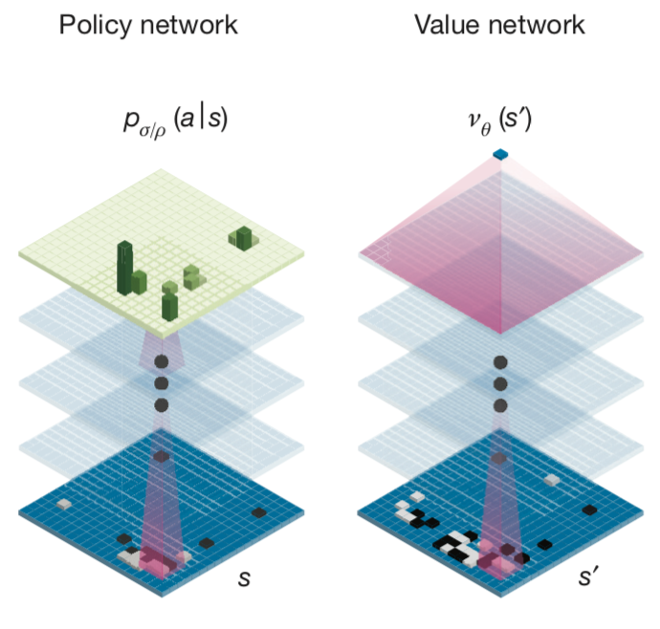
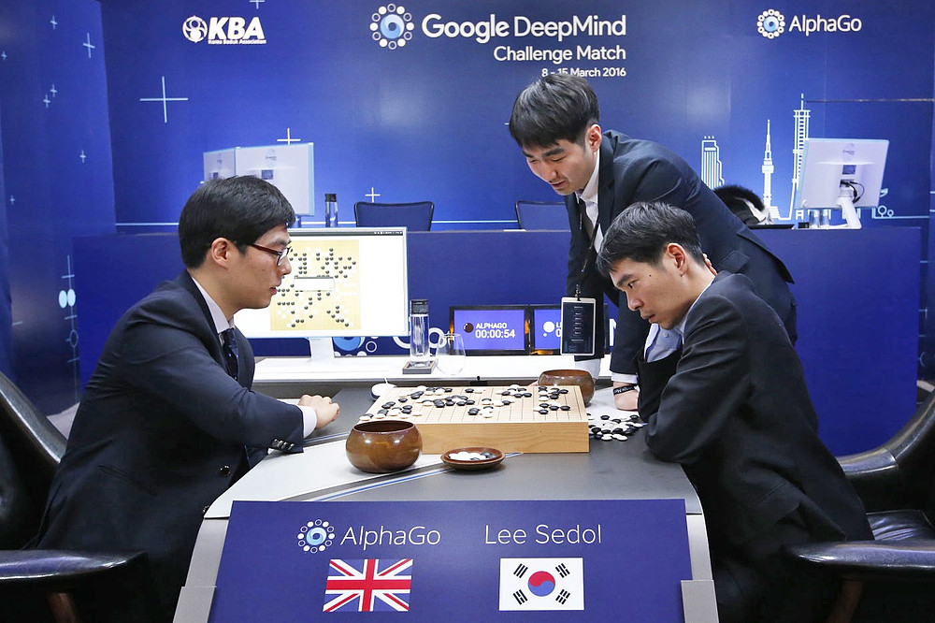
Deep Learning Deployment
Machine learning in Games(Go) applications
AlphaGo 2016
Image- public domain
Link Access
+ Hardware Requirement
1920 CPUs and 280GPUs
+ Energy consumption
$3000 electric bill /game
The Schematic representation of the neural network architecture used in AlphaGo
AlphaGo paper

Slide 5
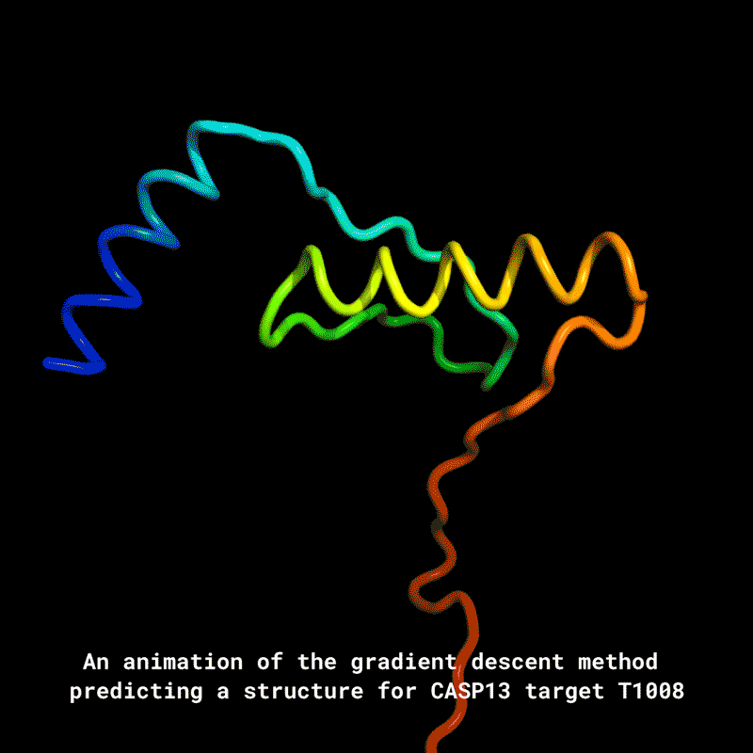
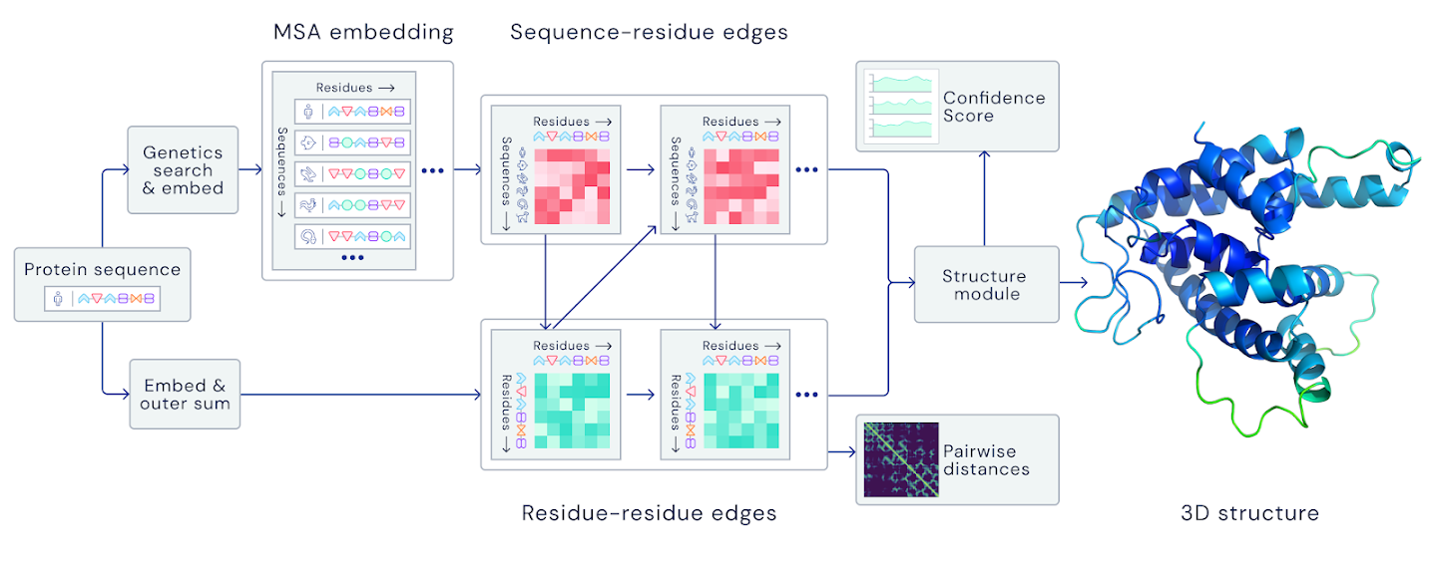

Deep Learning Deployment
Machine learning in Biomedical applications
(AlphaFold – AlphaFold 1)
The AlphaFold2 main neural network architecture - July/2021
+ Hardware Requirement Training
128 TPUv3 Cores (~100-200 GPUs)
(11 days training and finetuning stage)
Highly accurate protein structure prediction with AlphaFold1 Paper-Deep Mind - July/2021
https://deepmind.com/blog/article/AlphaFold-Using-AI-for-scientific-discovery

Slide 6
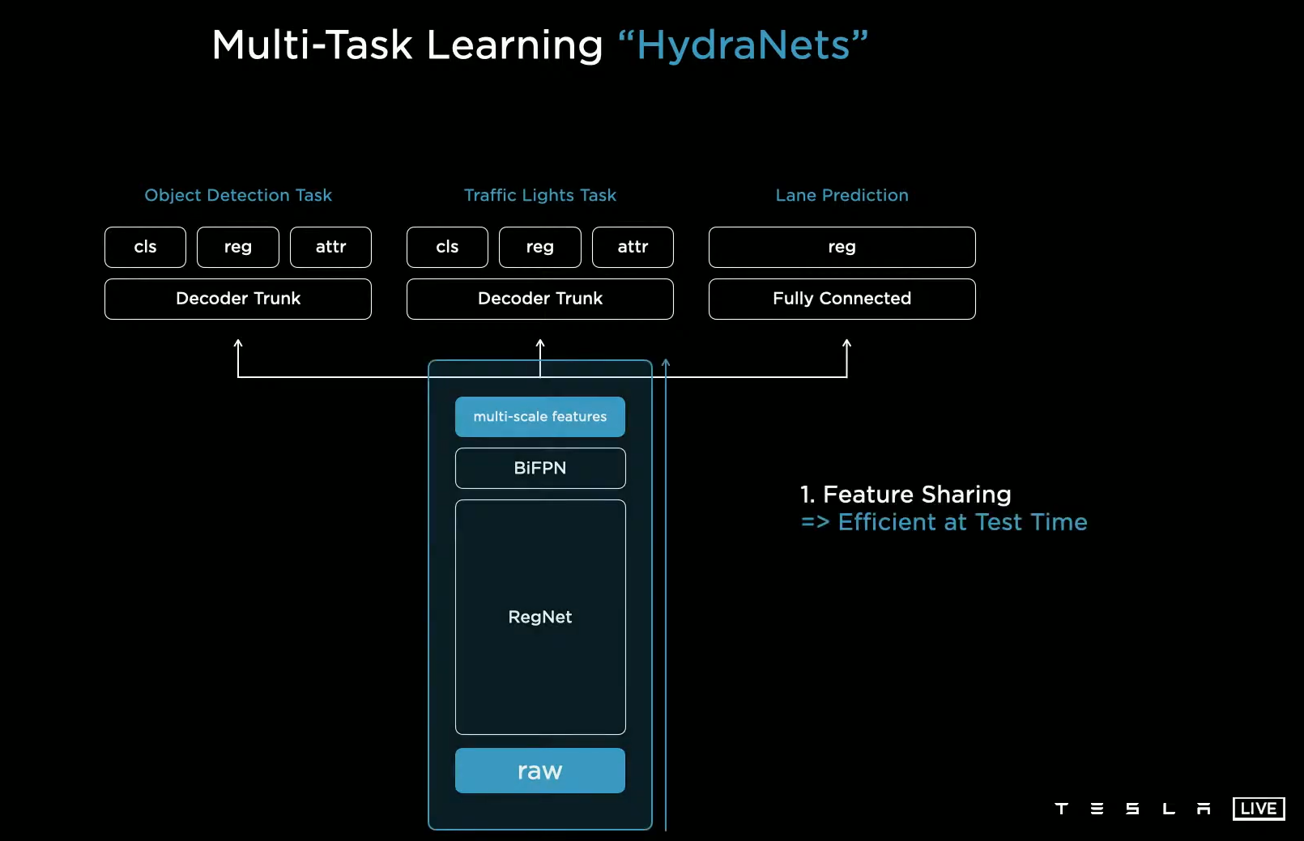
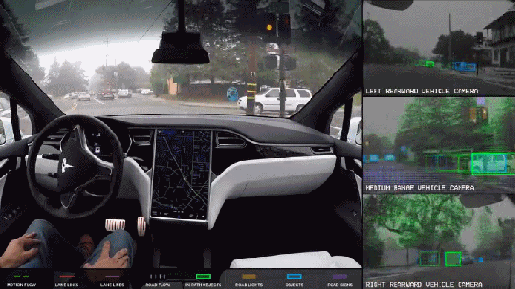
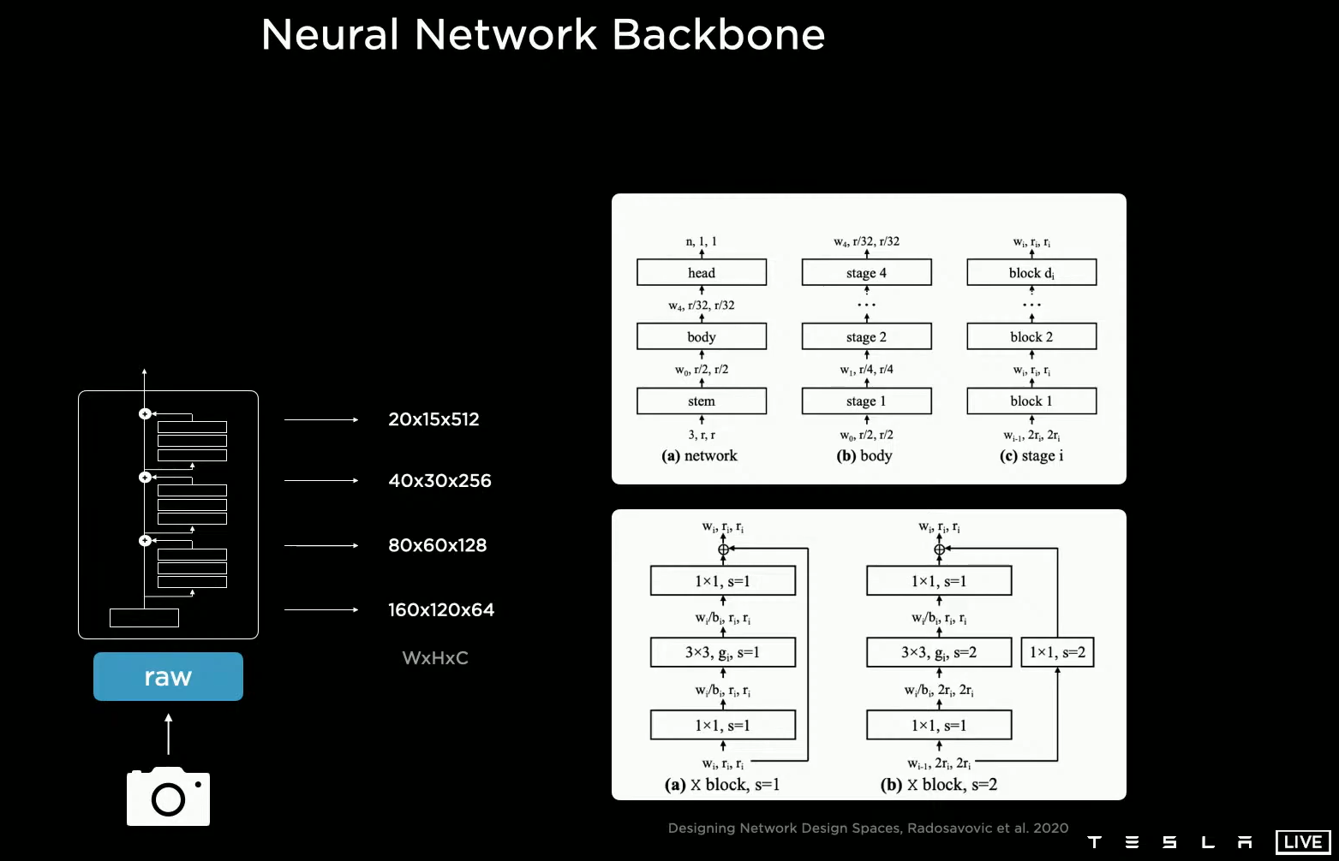
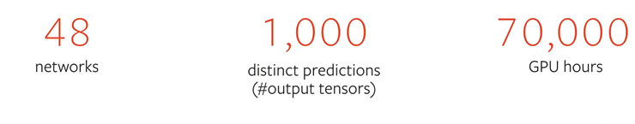
Deep Learning Deployment
Machine learning in Autonomous applications
Tesla full self driving Video Link 2019
+ Hardware for Training GPUs
Node 8GPUs TitanX training for 1 years
#Noted process of training is iterative update training
Tesla self-driving HydraNets architecture
Link Tesla’s AI Event day 12/08/2021
Link Tesla PyTorch Event day 11/2019

Slide 7
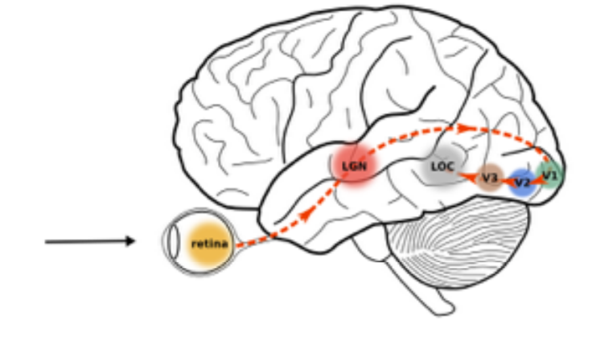
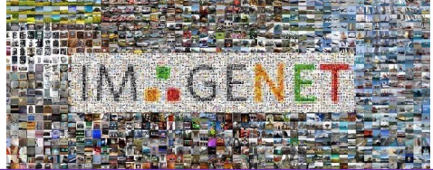
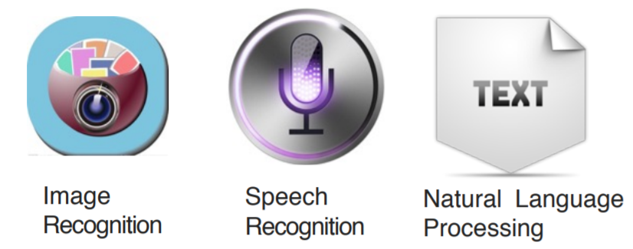
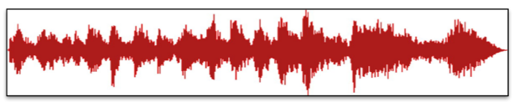

Deep Learning Deployment
Machine learning applications in Many aspect of Daily Life
Image- public domain
Link Access
Images
Audio
Text

Slide 8
2.
Machine Learning Deployment Challenges

Slide 9
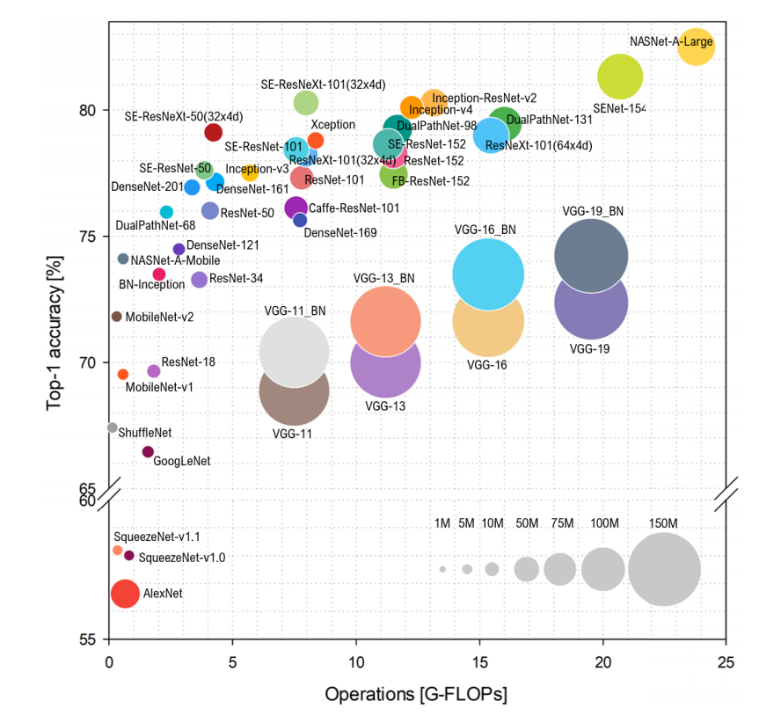
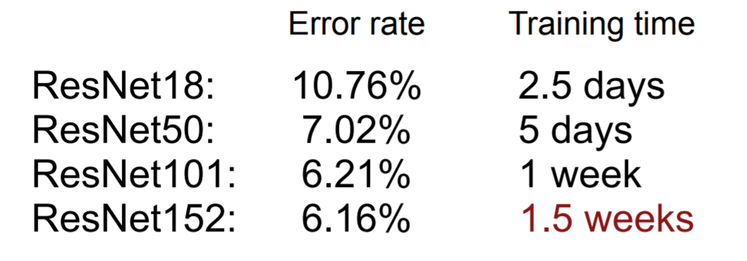
ML Optimization Computation Challenge
ResNet Family Training on ImageNet Dataset

Slide 10
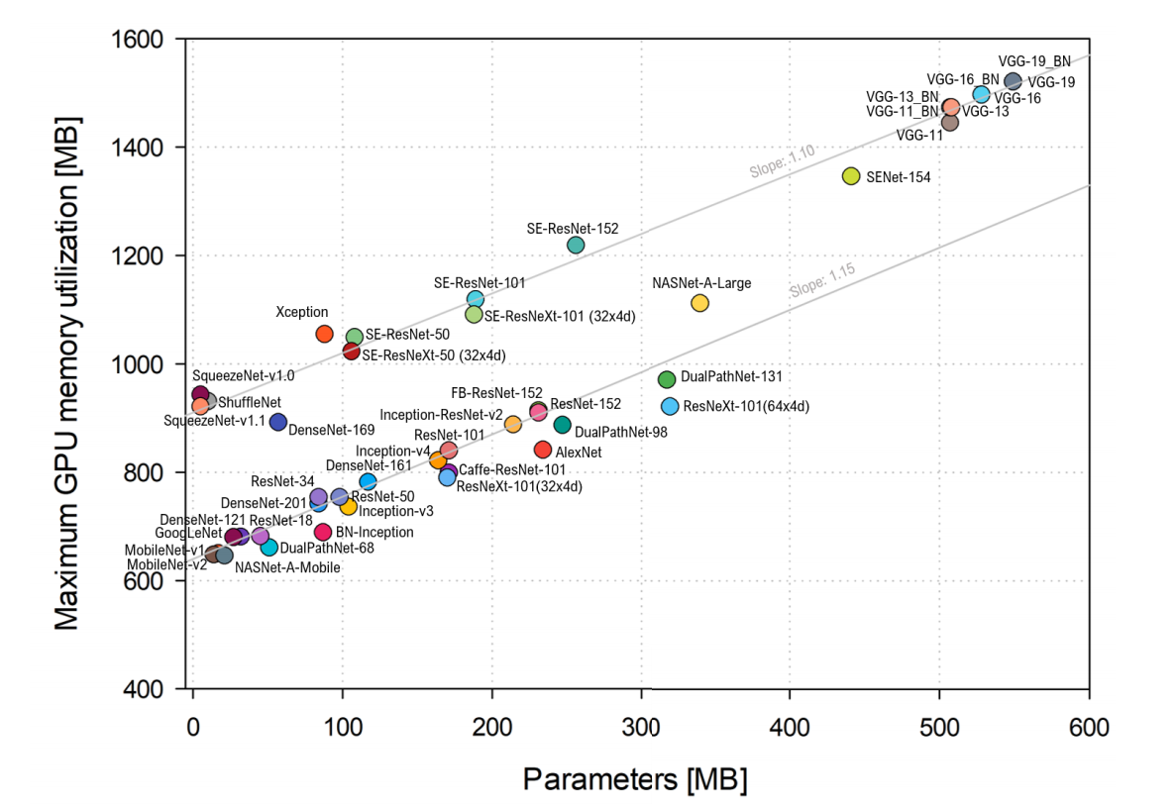
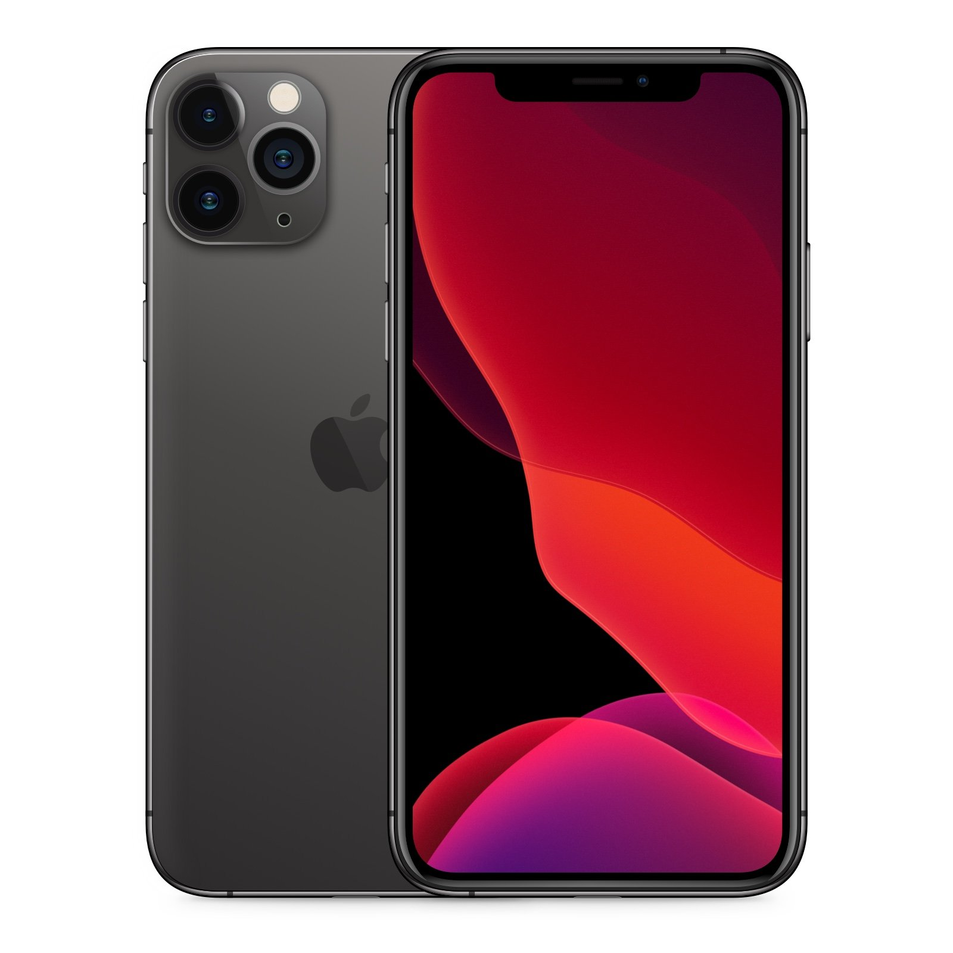
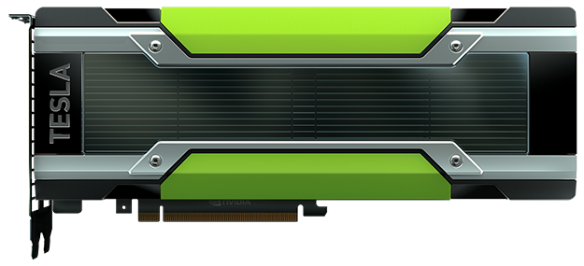
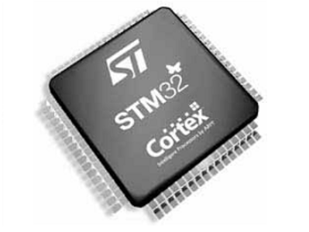
ML Optimization Size Challenge
Model Size Training and Deployment
Cloud computing
Mobiles
Embedded CPUs-MCUs
+ Memory: 32GB
Computation: TFLOPS/s
+ Memory: 4GB
Computation: TFLOPS/s
+ Memory: <100KB
Computation: MFLOPS/s
Image- public domain
Link Access
Image- public domain
Link Access
Deep Neural Network Architectures size Vs GPUs Titan Xp Memory Bianco et al 2018

Slide 11
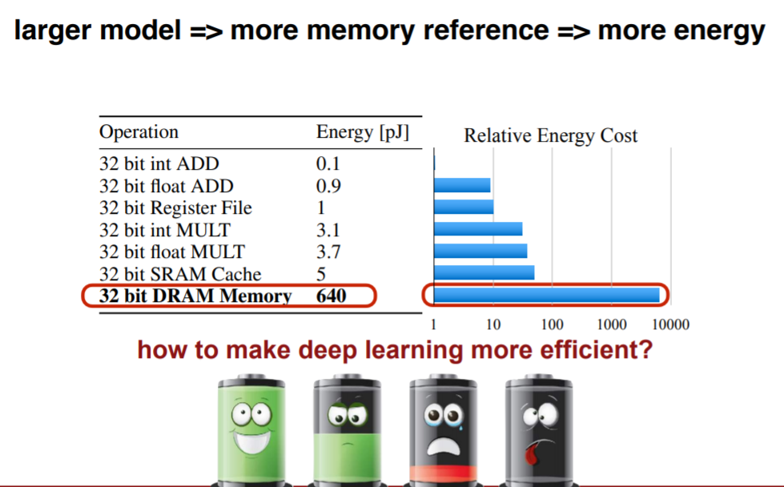
ML Optimization Energy Consumption Challenge

Slide 12
3.
Machine Learning Compression Techniques

Slide 13
Compression Techniques
Knowledge Distillation
Quantization
Binary Neural Net
Pruning
Weight Sharing
Factorization - Others

